Slide 1
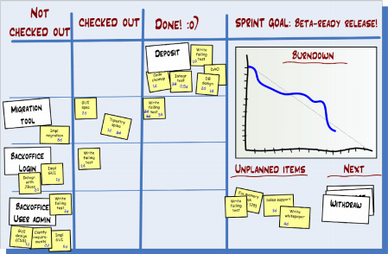
An Introduction to Scrum

Slide 2
What is Scrum?
Scrum:
Is an agile, lightweight process
Can manage and control software and product development
Uses iterative, incremental practices
Has a simple implementation
Increases productivity
Reduces time to benefits
Embraces adaptive, empirical systems development
Is not restricted to software development projects
Embraces the opposite of the waterfall approach…
Notes:
Scrum is an iterative and incremental agile software development framework for managing product development. It defines "a flexible, holistic product development strategy where a development team works as a unit to reach a common goal", challenges assumptions of the "traditional, sequential approach" to product development, and enables teams to self-organize by encouraging physical co-location or close online collaboration of all team members, as well as daily face-to-face communication among all team members and disciplines involved.

Slide 3





Scrum
24 hours
Sprint
2-4 weeks
Sprint goal
Return
Sprint backlog
Potentially shippable
product increment
Return
Cancel
Gift wrap
Coupons
Gift wrap
Cancel
Coupons
Product
backlog
Notes:
A Sprint (or iteration) is the basic unit of development in Scrum. The Sprint is a timeboxed effort; that is, it is restricted to a specific duration. The duration is fixed in advance for each Sprint and is normally between one week and one month, with two weeks being the most common.[Each Sprint starts with a Sprint Planning event that aims to define a Sprint Backlog, identify the work for the Sprint, and make an estimated commitment for the Sprint goal. Each Sprint ends with a Sprint Review and Sprint Retrospective, that reviews progress to show to stakeholders and identify lessons and improvements for the next Sprints.
Scrum emphasizes work that is really done at the end of the Sprint. In the case of software, this likely includes that the software has been fully integrated, tested and documented, and is potentially shippable.

Slide 4







Scrum Roles
Product Owner
Possibly a Product Manager or Project Sponsor
Decides features, release date, prioritization, $$$
Scrum Master
Typically a Project Manager or Team Leader
Responsible for enacting Scrum values and practices
Remove impediments / politics, keeps everyone productive
Project Team
5-10 members; Teams are self-organizing
Cross-functional: QA, Programmers, UI Designers, etc.
Membership should change only between sprints
Notes:
There are three core roles in the Scrum framework product owner, scrum master, project Team. These core roles are ideally collocated to deliver potentially shippable Product Increments. They represent the Scrum Team. Although other roles involved with product development may be encountered, Scrum does not define any team roles other than those described below.

Slide 5
Product owner
Define the features of the product
Decide on release date and content
Be responsible for the profitability of the product (ROI)
Prioritize features according to market value
Adjust features and priority every iteration, as needed
Accept or reject work results
Notes:
The Product Owner represents the product's stakeholders and the voice of the customer; and is accountable for ensuring that the team delivers value to the business. The Product Owner writes customer-centric items (typically user stories), prioritizes them based on importance and dependencies, and adds them to the Product Backlog. Scrum Teams should have one Product Owner. This role should not be combined with that of the Scrum Master.

Slide 6
The ScrumMaster
Represents management to the project
Responsible for enacting Scrum values and practices
Removes impediments
Ensure that the team is fully functional and productive
Enable close cooperation across all roles and functions
Shield the team from external interferences
Notes:
Scrum is facilitated by a Scrum Master, who is accountable for removing impediments to the ability of the team to deliver the product goals and deliverables. The Scrum Master is not a traditional team lead or project manager, but acts as a buffer between the team and any distracting influences. The Scrum Master ensures that the Scrum framework is followed.

Slide 7
The team
Typically 5-9 people
Cross-functional:
Programmers, testers, user experience designers, etc.
Members should be full-time
May be exceptions (e.g., database administrator)
Notes:
The Development Team is responsible for delivering potentially shippable increments of product at the end of each Sprint (the Sprint goal). A team is made up of 3–9 individuals who do the actual work (analyse, design, develop, test, technical communication, document, etc.). Development Teams are cross-functional, with all of the skills as a team necessary to create a Product Increment. The Development Team in Scrum is self-organizing, even though there may be some interaction with a project management office.

Slide 8
Sprint
Scrum projects make progress in a series of “sprints”
Analogous to Extreme Programming iterations
Typical duration is 2–4 weeks or a calendar month at most
A constant duration leads to a better rhythm
Product is designed, coded, and tested during the sprint
Notes:
Scrum Sprint is a repeatable fixed time-box during which a "Done" product of the highest possible value is created. Sprint lies at the core of the Sprint agile methodology and can be thought of as an event which wraps all other Scrum events like Daily Scrums, Scrum Review and Sprint Retrospective. Like all of scrum events, Sprint also has a maximum duration. Usually, a Sprint lasts for one month or less.

Slide 9
Sprint planning
Team selects items from the product backlog they can commit to completing
Sprint backlog is created
Tasks are identified and each is estimated (1-16 hours)
Collaboratively, not done alone by the ScrumMaster
High-level design is considered
Notes:
At the beginning of a Sprint, the Scrum Team holds a Sprint Planning event to:
Communicate the scope of work that is intended to be done during that Sprint
Select Product Backlog Items that can be completed in one Sprint
Prepare the Sprint Backlog that details the work needed to finish the selected Product Backlog Items
Time-boxed to a four-hour limit for a two-week Sprint (pro rata for other Sprint durations)
During the first half, the whole Scrum Team (Development Team, Scrum Master, and Product Owner) selects the Product Backlog Items which might be achievable in that Sprint.
During the second half, the Development Team decomposes the work items (tasks) required to deliver those Product Backlog Items; resulting in a confirmed Sprint Backlog.
Some Product Backlog Items may be split or deprioritized if the identified work is not achievable in that Sprint
Once the Development Team prepares the Sprint Backlog, they commit (usually by voting) to deliver tasks within the Sprint.

Slide 10
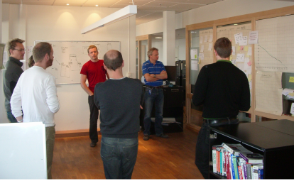
Daily Scrum Meeting
Parameters
Daily, ~15 minutes, Stand-up
Anyone late pays a $1 fee
Not for problem solving
Whole world is invited
Only team members, Scrum Master, product owner, can talk
Helps avoid other unnecessary meetings
Three questions answered by each team member:
What did you do yesterday?
What will you do today?
What obstacles are in your way?
Notes:
Each day during a Sprint, the team holds a Daily Scrum with specific guidelines:
All members of the Development Team come prepared. The Daily Scrum...
...starts precisely on time even if some Development Team members are missing
...should happen at the same time and place every day
...is limited to fifteen minutes
Anyone is welcome, though normally only Scrum Team roles contribute.
During the Daily Scrum, each team-member answers three questions:
What did I do yesterday that helped the Development Team meet the Sprint goal?
What will I do today to help the Development Team meet the Sprint goal?
Do I see any impediment that prevents me or the Development Team from meeting the Sprint goal?

Slide 11
Scrum's Artefacts
Scrum has remarkably few artefacts
Product Backlog
Sprint Backlog
Burndown Charts
Can be managed using just an Excel spreadsheet
More advanced / complicated tools exist:
Expensive
Web-based – no good for Scrum Master/project manager who travels
Still under development
Notes:
Scrum artifacts are designed to increase transparency of information related to the delivery of the project, and provide opportunities for inspection and adaptation. They are management products useful for the creation of the specialist product of the project.
There are three artifacts in Scrum:
Product Backlog: An ordered list of everything that might be needed in the final product
Sprint Backlog: Selected items from the Product Backlog to be delivered through a Sprint, along with the tasks for delivering the items and realizing the Sprint Goal
Increment:The set of all the Product Backlog items completed so far in the project (up to the end of a certain Sprint)

Slide 12


Product Backlog
The requirements
A list of all desired work on project
Ideally expressed as a list of user stories along with "story points", such that each item has value to users or customers of the product
Prioritized by the product owner
Reprioritized at start of each sprint
This is the product backlog
Notes:
The Product backlog is the place where the Product owner gathers and prioritizes all the functionality and deliverables he wants the team to work on.
The backlog should contain all work currently on the horizon.
The Product owner prioritizes the Product backlog by value.
Often team members or external stakeholders have ideas that they want to add to the Product backlog. These can be added in the unscheduled section at the end of the backlog.
teams in the product backlog need to be estimated by the team for the Product owner to understand their size. If no future perspective is required this can happen right before planning a new sprint.
The Product backlog for each team is located in the spreadsheet used by the team to plan and track their sprints.

Slide 13
User Stories
Instead of Use Cases, Agile project owners do "user stories"
Who (user role) – Is this a customer, employee, admin, etc.?
What (goal) – What functionality must be achieved/developed?
Why (reason) – Why does user want to accomplish this goal?
As a [user role], I want to [goal], so I can [reason].
Example:
"As a user, I want to log in, so I can access subscriber content."
story points: Rating of effort needed to implement this story
common scales: 1-10, shirt sizes (XS, S, M, L, XL), etc.
Notes:
user story is a description consisting of one or more sentences in the everyday or business language of the end user or user of a system that captures what a user does or needs to do as part of his or her job function. User stories are used with agile software development methodologies as the basis for defining the functions a business system must provide, and to facilitate requirements management. It captures the "who", "what" and "why" of a requirement in a simple, concise way, often limited in detail by what can be hand-written on a small paper notecard.

Slide 14
Sprint Backlog
Individuals sign up for work of their own choosing
Work is never assigned
Estimated work remaining is updated daily
Any team member can add, delete change sprint backlog
Work for the sprint emerges
If work is unclear, define a sprint backlog item with a larger amount of time and break it down later
Update work remaining as more becomes known
Notes:
The Sprint Backlog is the list of work the Development Team must address during the next Sprint.The list is derived by the Scrum Team progressively selecting Product Backlog Items in priority order from the top of the Product Backlog until they feel they have enough work to fill the Sprint. The Development Team should keep in mind its past performance assessing its capacity for the new Sprint, and use this as a guide line of how much 'effort' they can complete.

Slide 15
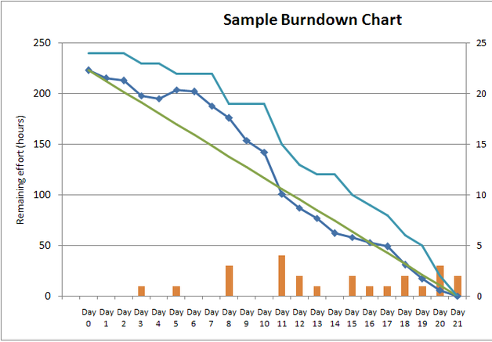
Sprint Burndown Chart
A display of what work has been completed and what is left to complete
one for each developer or work item
updated every day
(make best guess about hours/points completed each day)
variation: Release burndown chart
shows overall progress
updated at end of each sprint
Notes:
A burn down chart is a graphical representation of work left to do versus time. The outstanding work (or backlog) is often on the vertical axis, with time along the horizontal. That is, it is a run chart of outstanding work. It is useful for predicting when all of the work will be completed. It is often used in agile software development methodologies such as Scrum. However, burn down charts can be applied to any project containing measurable progress over time.
Outstanding work can be represented in terms of either time or story points.

Slide 16
The Sprint Review
Team presents what it accomplished during the sprint
Typically takes the form of a demo of new features or underlying architecture
Informal
2-hour prep time rule
No slides
Whole team participates
Invite the world
Notes:
At the end of a Sprint, the team holds two events: the Sprint Review and the Sprint Retrospective.
At the Sprint Review, the team:
Reviews the work that was completed and the planned work that was not completed
Presents the completed work to the stakeholders (a.k.a. the demo)
Guidelines for Sprint Reviews:
Incomplete work cannot be demonstrated
The recommended duration is two hours for a two-week Sprint (pro-rata for other Sprint durations)
At the Sprint Retrospective, the team:
Reflects on the past Sprint
Identifies and agrees on continuous process improvement actions
Guidelines for Sprint Retrospectives:
Two main questions are asked in the Sprint Retrospective: What went well during the Sprint? What could be improved in the next Sprint?
The recommended duration is one-and-a-half hours for a two-week Sprint (pro-rata for other Sprint durations)
This event is facilitated by the Scrum Master

Slide 17
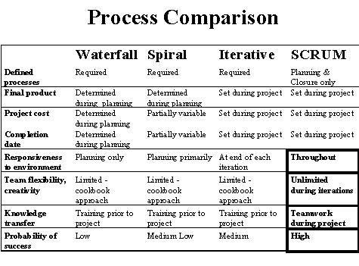
Scrum vs. Other Models
Notes:
The sprint process allows for "good enough" development that results in a saleable product even while the project is in full swing. This incremental delivery system shortens the time to market and may result in higher revenue, as each completed backlog represents a new release of the product. In addition, reviewing each sprint before moving to the next means that testing is conducted throughout the process, which allows teams to change the scope or direction of the project at any point. Although the deadline and budget are fixed variables, the project requirements are not. In fact, stakeholders and participants anticipate changes along the way. The product owner's involvement in the project management process facilitates these changes.

